Slide 1



WAVECON TELECOM ANALYSIS
WEEK 2 -TASK 4
RAVINA KARNIK

Slide 2

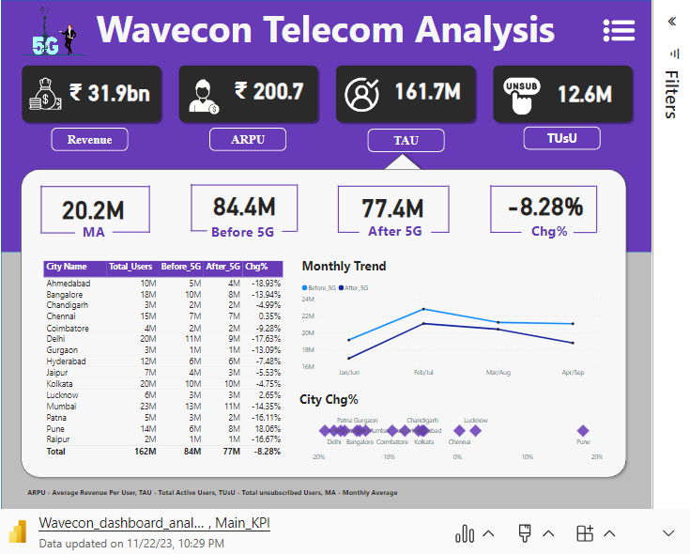
Microsoft Power BI

Slide 3





OBJECTIVES
Revenue
KPI
Plan
Plan Affected
discontinued
impact of the 5G launch on our revenue
underperforming KPI’s after the 5G launch
Plan analysis after 5G launch
Plan affected largely by the 5G launch
discontinued Plan

Slide 4
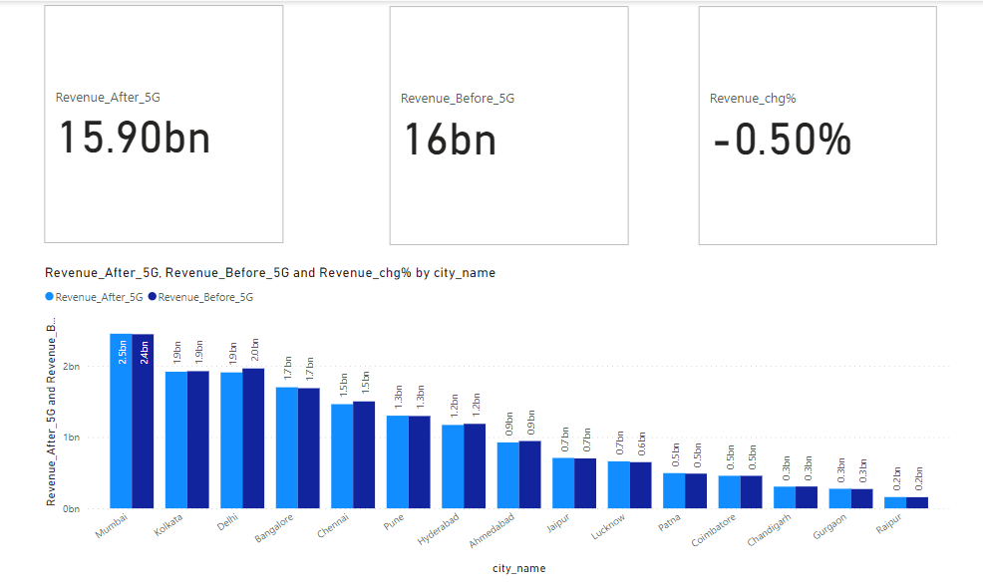
What is the impact of the 5G launch on our revenue?
Revenue after 5G
Revenue before 5G
Revenue change %
15.90 bn
16.00 bn
-0.50 %

Slide 5
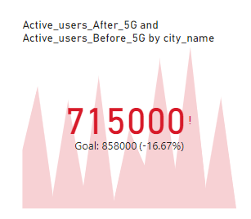

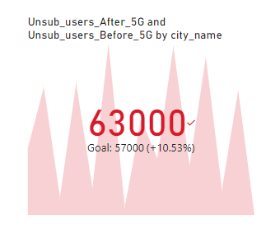

Which KPI is underperforming after the 5G launch?
Active users after 5G
Unsub_users after 5G
77 M
6 M
Active users before 5G
Unsub_users after 5G
84 M
7 M
Active users change %
Unsub_users chg % 5G
-8.28 %
23.50%

Slide 6
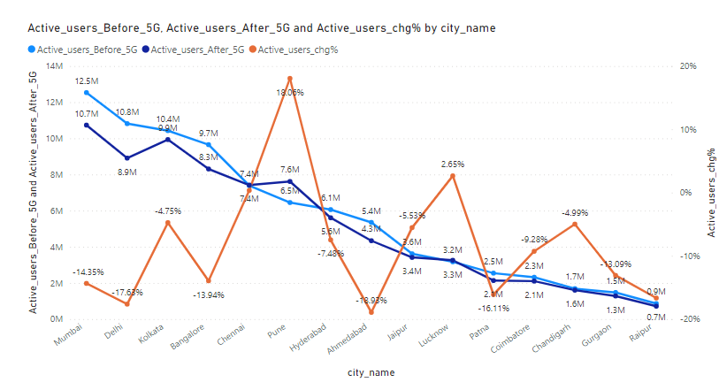
Pune city has positive high percentage change +18% which means active users are increases after 5G launch.
Only Three cities Chennai, Pune, Lucknow have positive change. others have negative change %

Slide 7
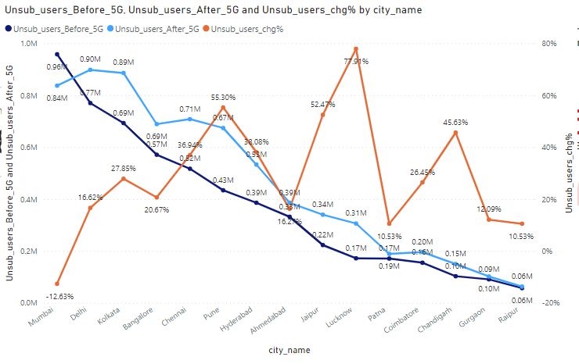
Only /Mumbai city has negative percentage change -12.63% which means unsubscribed users are decreases after 5G launch.
Remaining all cities have unsubscribe users are increases after 5G launch.

Slide 8
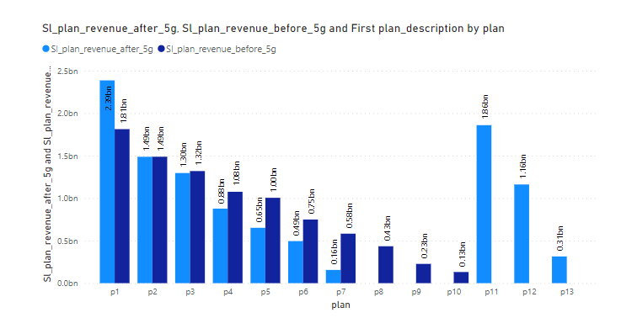
After the 5G launch, which plans are performing well and Which are not performing well in terms of revenue?
only plan p1 is performing well because its value is increases after 5G launch.
Plan p11,p12 and p13 are launched after 5G launches and in that p11 and p12 are performing well as compared to p13.

Slide 9
Is there any plan affected largely by the 5G launch? Should we continue or discontinue that plan?
Plan p8(Daily Saviour (1 GB / Day) validity: 1 Day),p9(Combo TopUp: 14.95 Talktime and 300 MB data),p10(Big Combo Pack (6 GB / Day) validity: 3 Days) are largely affected by the 5G launch.they have zero increment in their revenue hence we discontinue with that plan.

Slide 10
Is there any plan that is discontinued after the 5G launch? What is the reason for it?

Slide 11
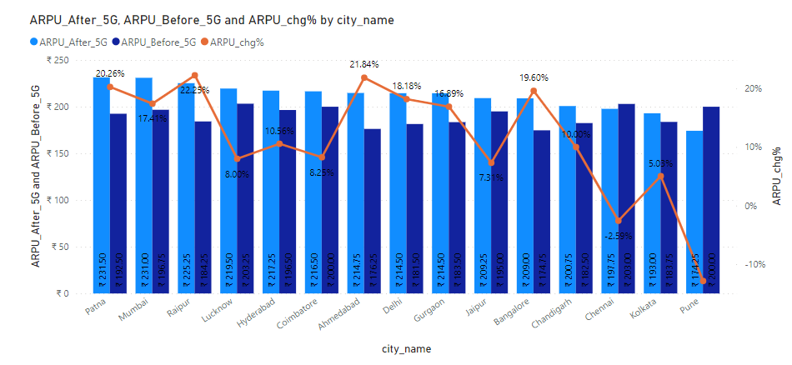
Impact of 5G launch on ARPU in different cities

Slide 12
IMPACT OF 5G LAUNCH
Bottom
5
Top
5

Slide 13





Revenue Elevation Strategies
Exclusive Promotions
Customized Offerings:
Offer special promotions and discounts to existing customers for contract renewals.
Adapt services based on the unique needs of different regions.
Workshops and Webinars
Broaden Service Offerings:
Workshops and Webinars: Conduct educational sessions to showcase the benefits of premium services
Broaden Service Offerings: Introduce new services such as high-speed internet, smart home solutions, or enterprise package

Slide 14

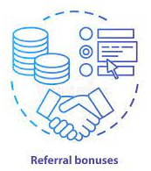


Active Users Increase Strategies
Employee Training:
Incentivized Referrals:
Train employees to provide excellent customer service and support
Launch a referral program offering discounts or additional data for customers who refer new users.
Language Options:
Interactive Apps:
Language Options: Provide multilingual support to cater to a wider audience.
Develop interactive mobile apps with features like bill tracking, data usage monitoring, and customer support.

